Slide 1

Code
Innovation
Series
Hackathon 2020
Model Engineering College
TEAM HEALTH TECHIES

Slide 2

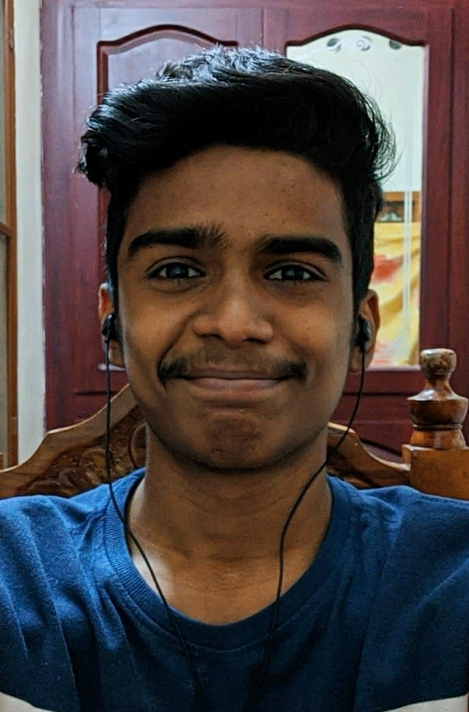
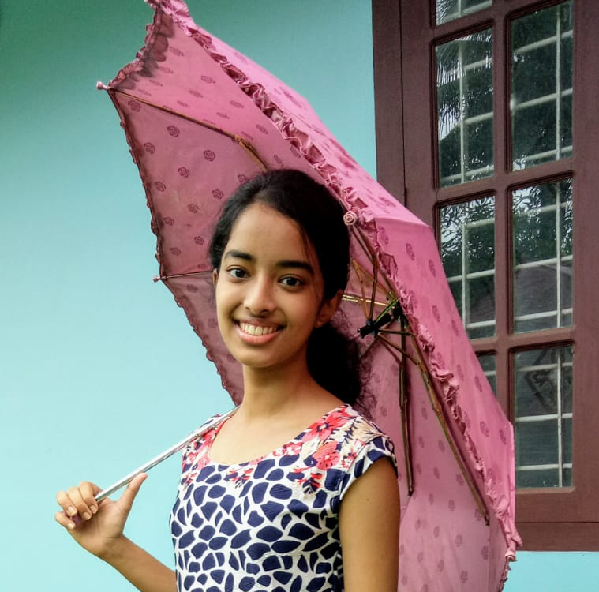
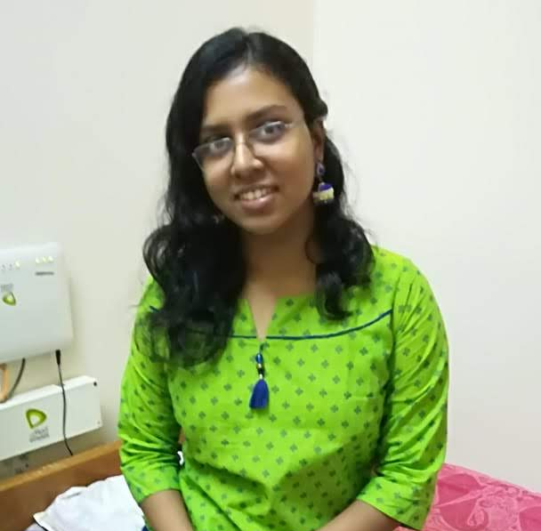
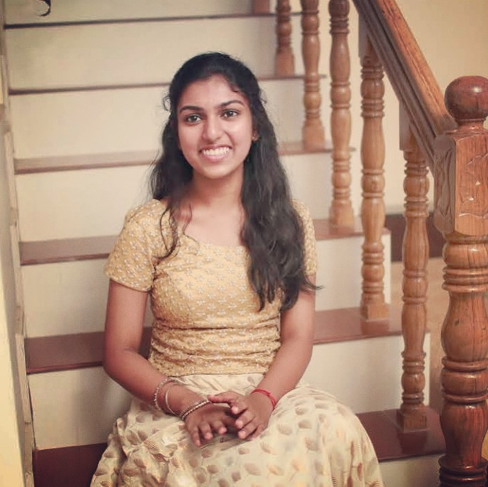
Meet Our Team
HEALTH TECHIES
Amjad Ali PS
CSB
Lisa V Cherian
CSA
Maria Anna Philip
CSB
Navya PS
CSA

Slide 3


PROBLEM STATEMENT
OUR HACK
Enabling a patient-centered information exchange system
An Aadhar based dynamic national repository of medical records of citizens for effective healthcare management
An Aadhar based dynamic national repository of medical records of the citizens for an effective healthcare management.
Health Tech

Slide 4
PROBLEMS
Faced by Doctors
Faced by Patients
Patients often have to carry numerous health documents while visiting a doctor.
Documents are often lost or ruined from natural calamities such as floods.
Health records are not accessible all the time or across the country.
Documents might not be available at times of emergency.
Unavailability of patient’s past medical records for reference.
Unawareness of various allergies and hereditary diseases the patient may have.
Difficulty in pinpointing the timelines of the diseases on the patient’s records.
Patients may often hide or lie about the presence or absence of certain medical conditions.

Slide 5
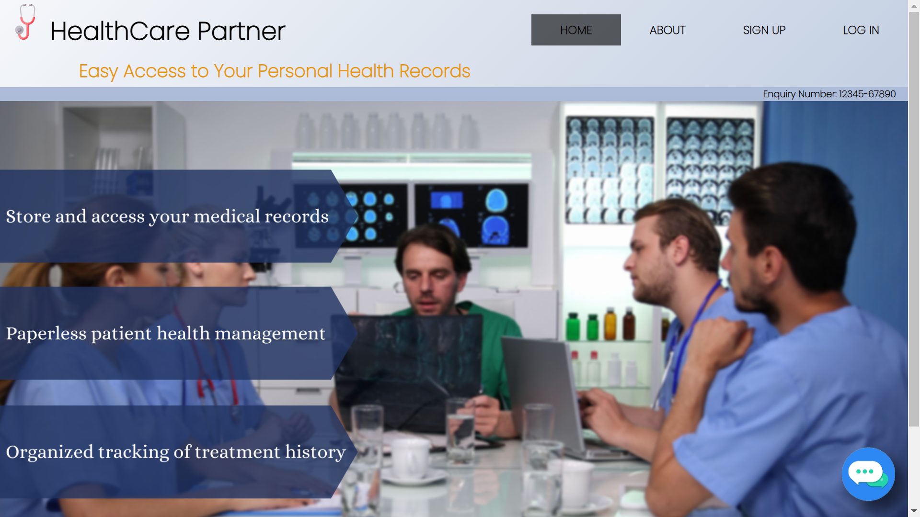
OUR SOLUTION

Slide 6






OBJECTIVES
Demystifies doctor-patient relationship
Brings healthcare information into public domain
Builds a decision support system
for the health care fraternity
Establishes a patient support system
Brings a paradigm which puts disease diagnostics in perspective

Slide 7


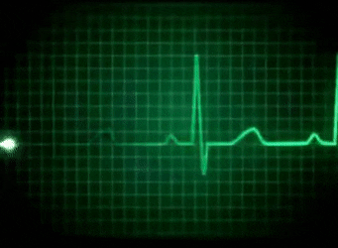

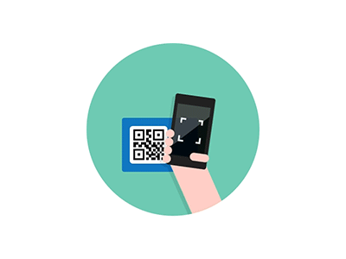
MAIN FEATURES
Digital patient health management reduces dependency on papers. Thus making it easier for doctors and patients, and making the system eco-friendly.
A two-step verification process will be done through OTP before a doctor can access a patient’s records, thus adding a double layer of security.
Documents like X-rays, ECGs, MRI scans, etc and prescriptions can be uploaded in the patient’s records with ease.
Users can link their accounts with their family members so that they can view their records and vice-versa.
Each user will have a unique Health ID and QR code which when scanned by a registered doctor will let him/her access and manipulate the patient’s medical records.

Slide 8
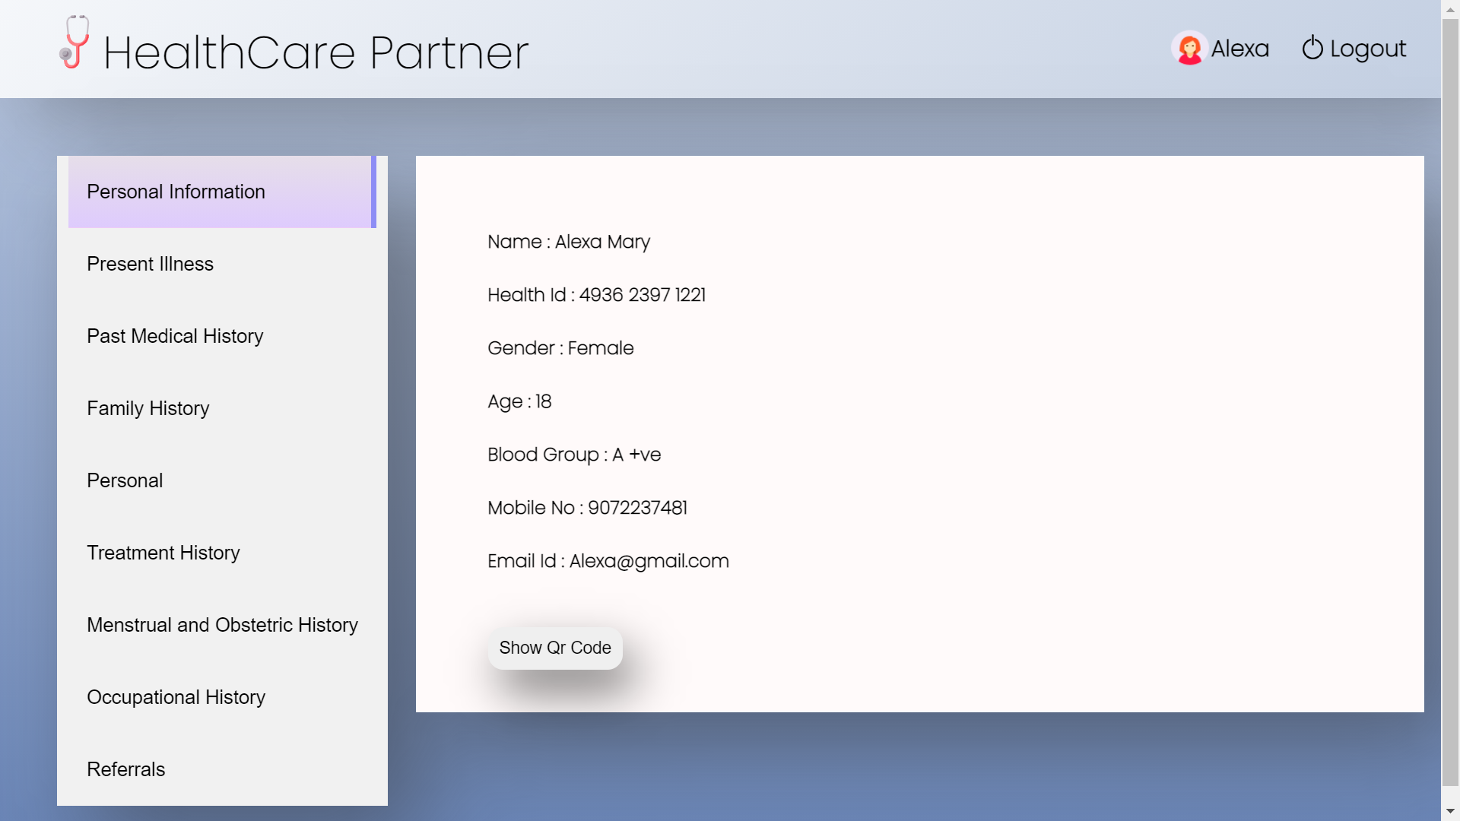
Doctors can easily access the patient’s information and past medical records by clicking on appropriate tabs.

Slide 9
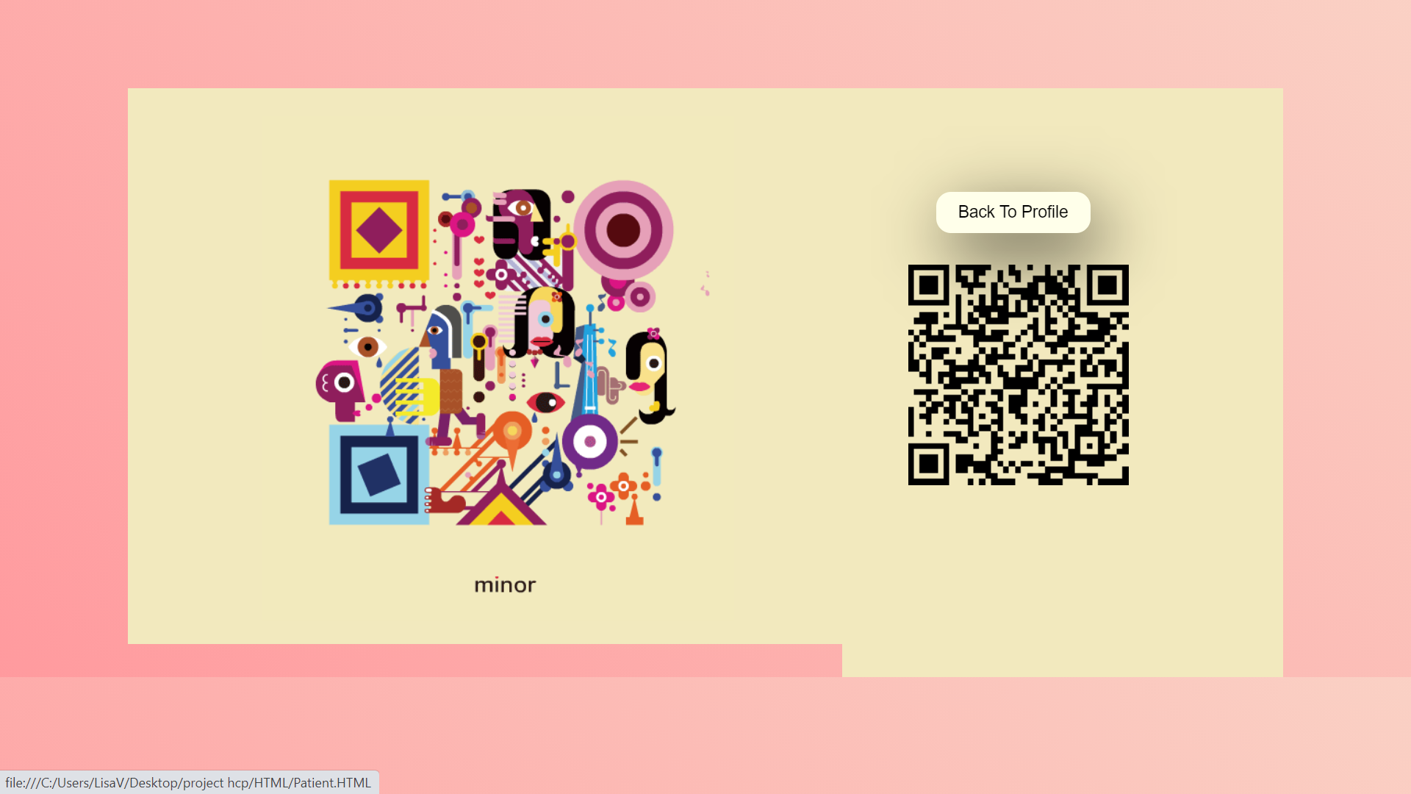
A unique QR code is generated for each patient which when scanned by a registered doctor will let him/her access and manipulate the patient’s medical records.

Slide 10
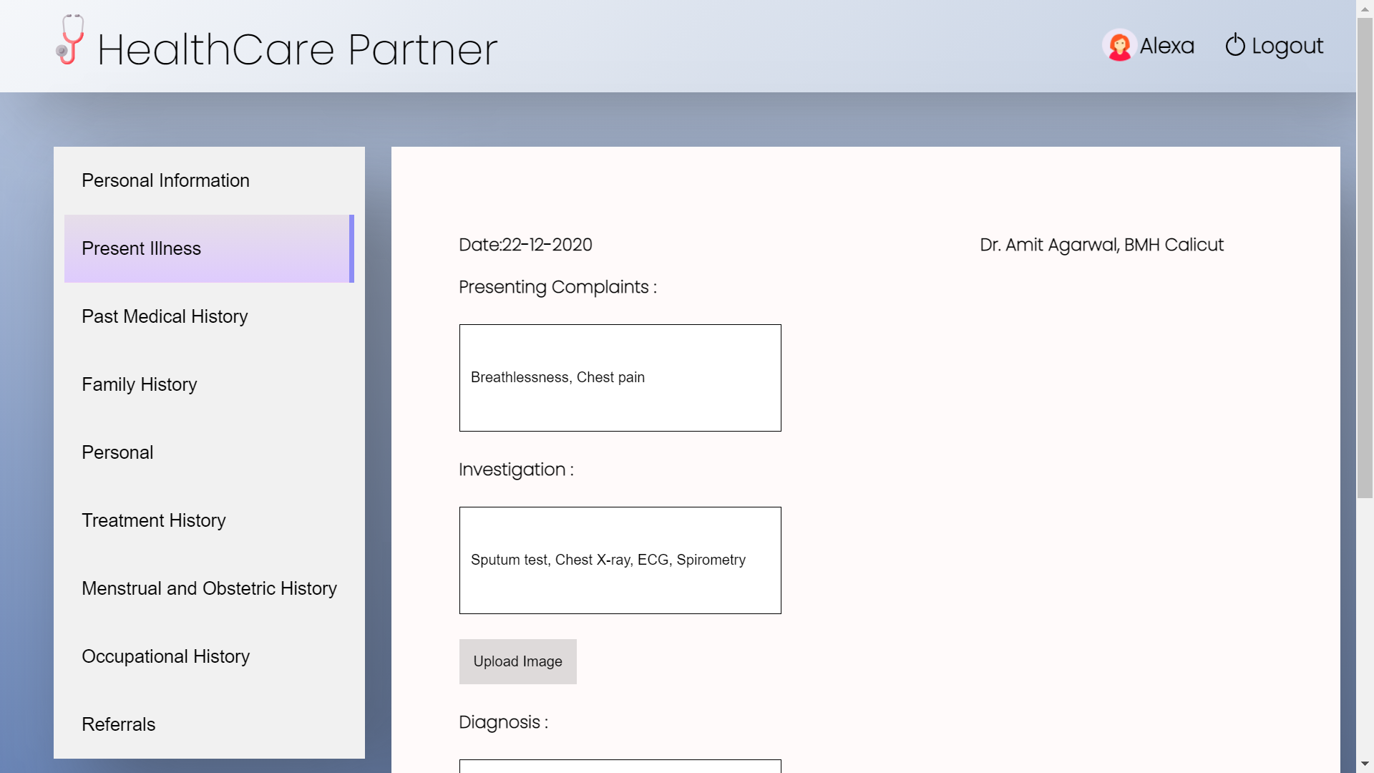
After scanning the QR code, the doctor can enter the details as shown below. Documents like X-rays, ECGs, MRI scans can also be uploaded through the “Upload Image” button.

Slide 11
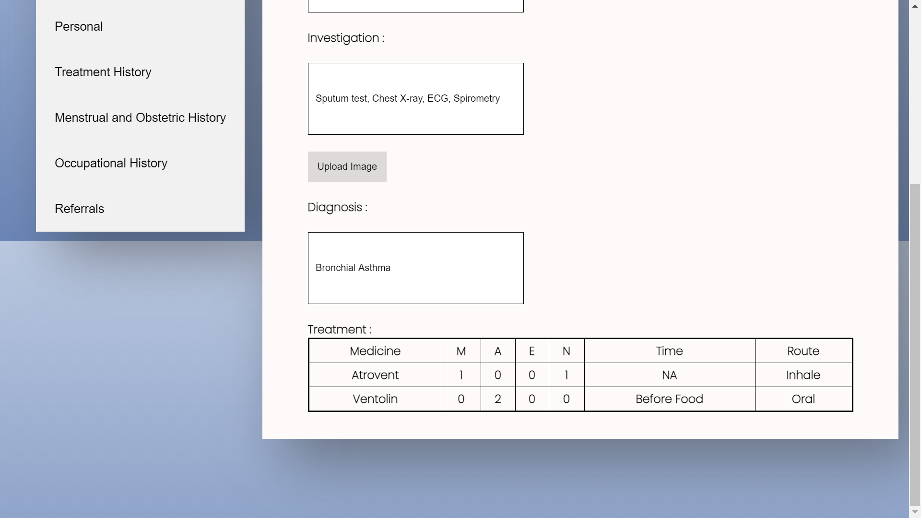
Final diagnosis and prescriptions can be entered as shown.

Slide 12
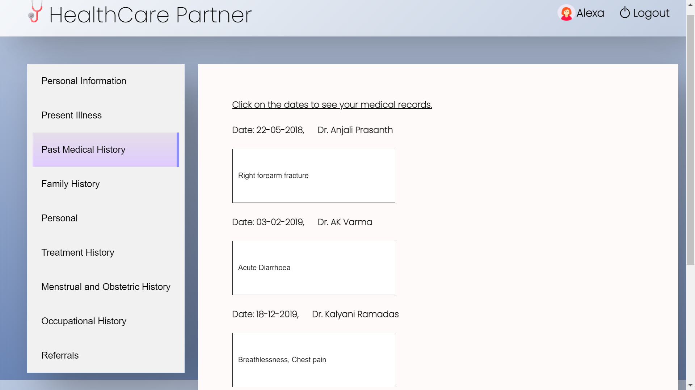
Past medical records are easily accessible. This helps doctors for intuitive patient care, and helps patients by not having to carry around paper documents.

Slide 13
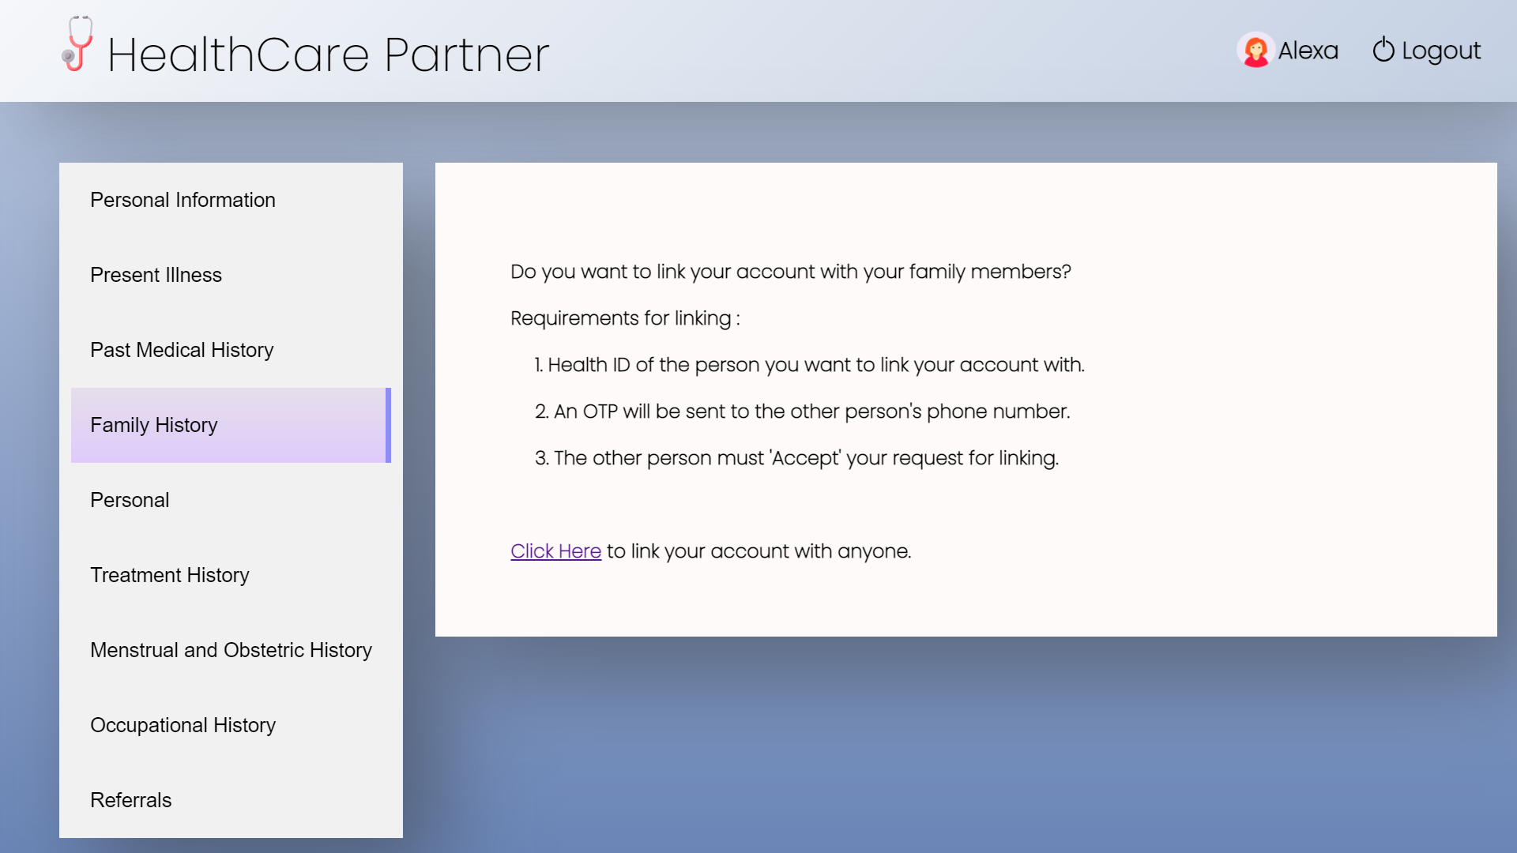
Link your account with your family members and loved ones so that they can see your health records and vice-versa. This feature is especially useful for those whose parents or children are away from them.

Slide 14
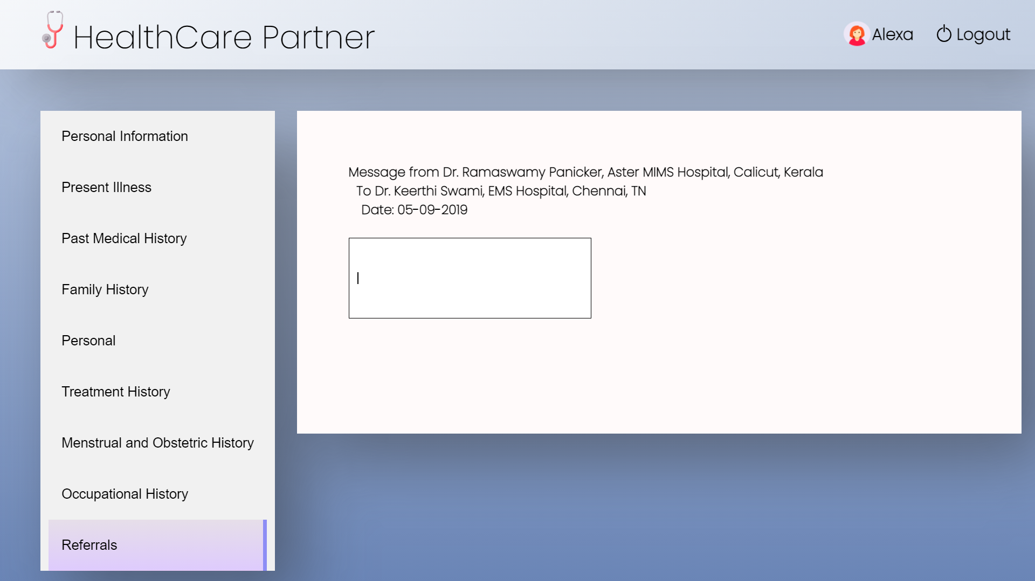
Referrals from one doctor to another doctor or health service, asking them to diagnose or treat a patient for a particular condition can be easily written in the Referrals tab.

Slide 15
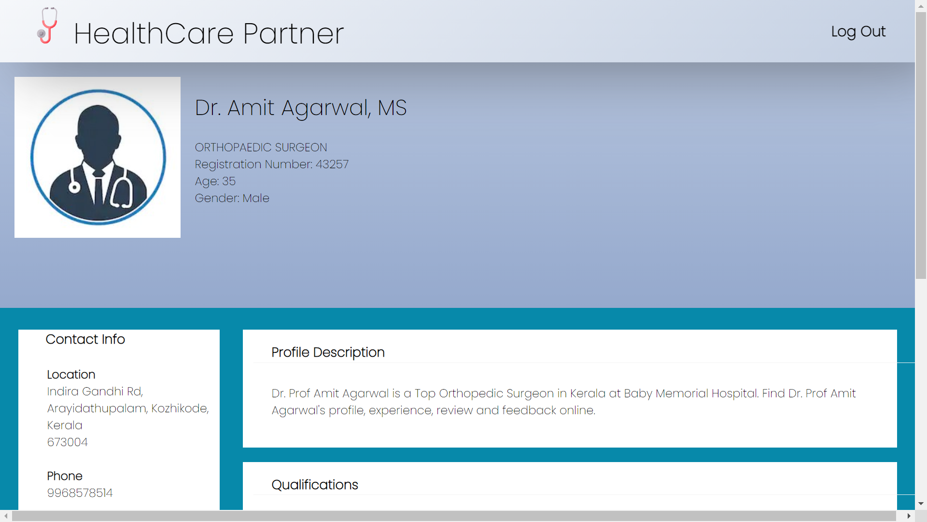
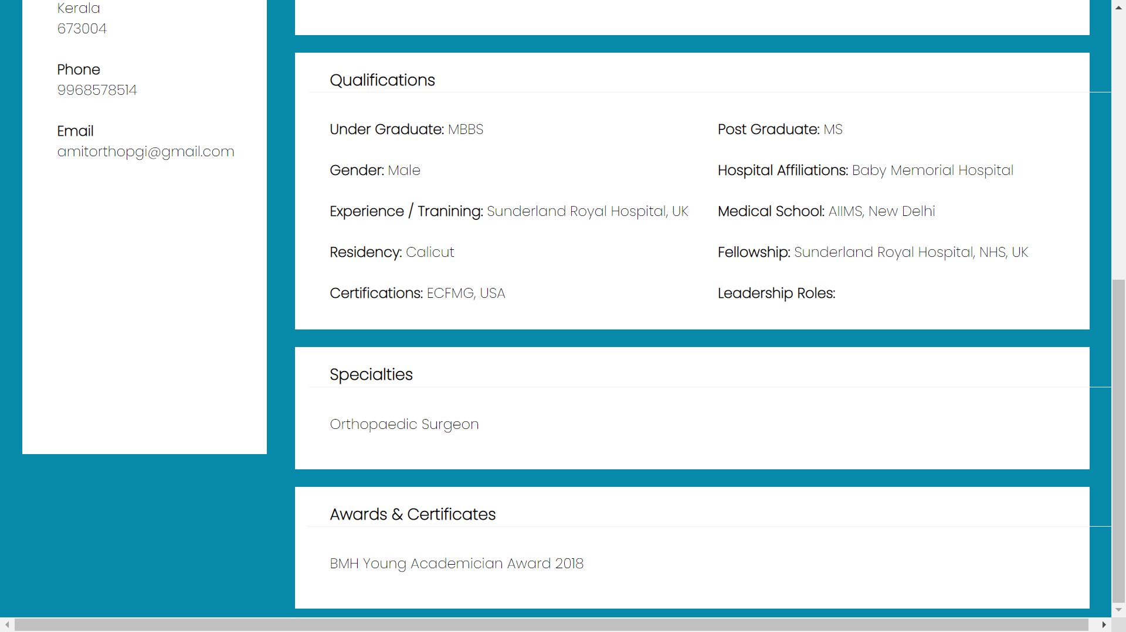
Doctors have their own accounts which shows their general information like hospital/clinic name, medical qualifications, contact info, etc.

Slide 16
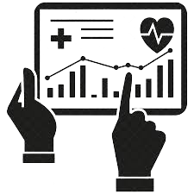

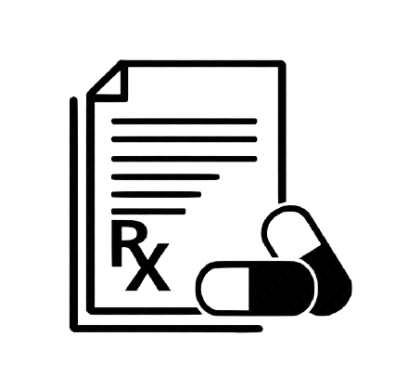



ADVANTAGES
Statistical studies:
Prevalence of specific diseases
Statistics and spread pattern of epidemics
Effectiveness of medicines and vaccines in a region
Malnutritional levels
Helps in planning future disease prevention and management programmes
Reduces cases of misprescription, overprescription and maltreatment of patients
Social studies:
Socio-economic status of people being affected
Gender based studies of diseases
Helps acquire information required to substantiate medico-legal cases
Central availability of
data for easy access
to authorised personnel

Slide 17
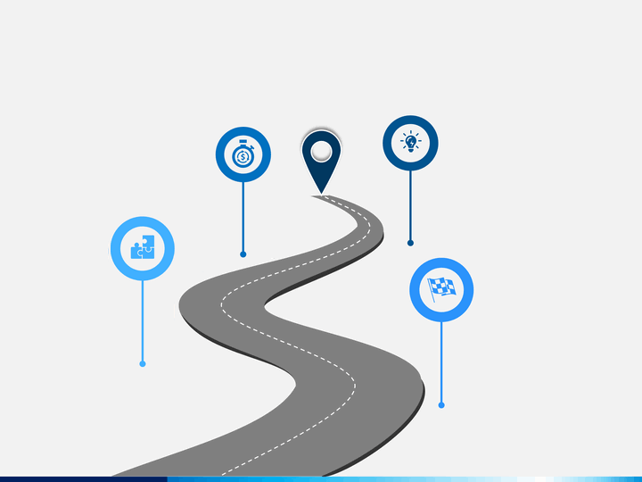
Option of Patient Confidentiality of illness status with linked family members (restricted/full access)
Accessibility of digitally verified medical certificates (birth, death certificates etc)
Road Ahead
Long term tracking of patient’s blood pressure and blood sugar levels
Categorisation of patient history into various sub-specialities

Slide 18

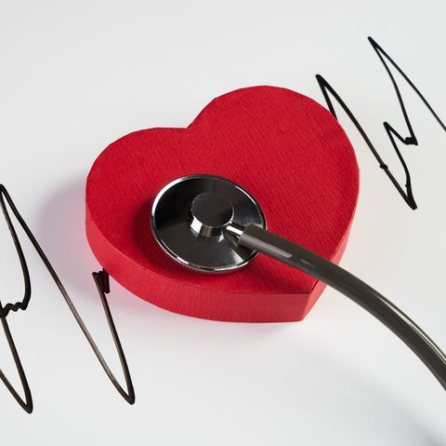

SOCIAL IMPACTS
Environment Friendly
Good Health and Well-being
Faster Dedicated Services

Slide 19
THANK YOU
Hackathon 2020

